Slide 1
Linear algebra

Slide 2
Matrices

Slide 3
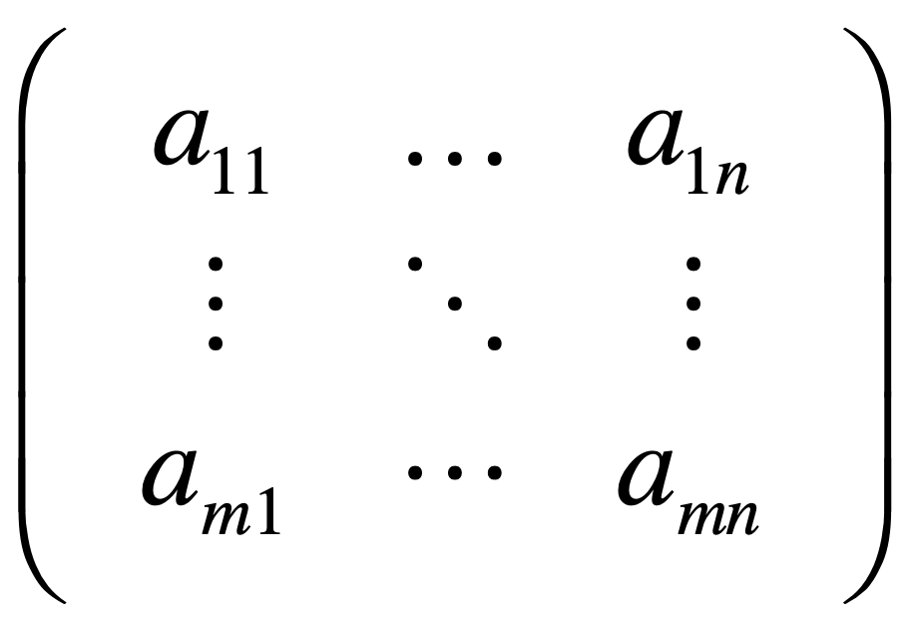

Slide 4
Vectors

Slide 5
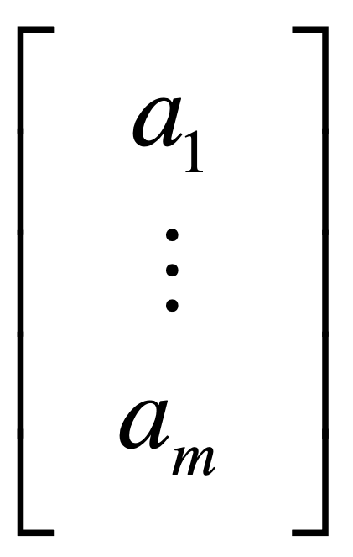

Slide 6
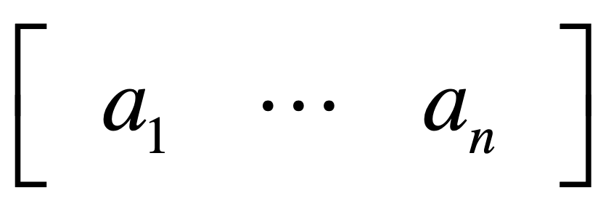

Slide 7
a sequence of numbers

Slide 8
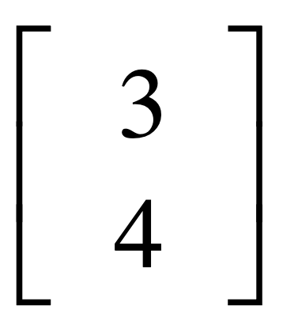
y
4
x
3

Slide 9
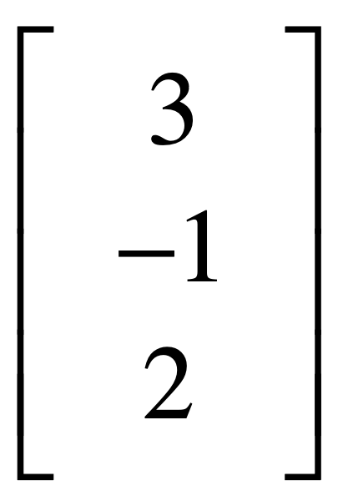
z
2
3
x
-1
y

Slide 10
vector multiplication

Slide 11
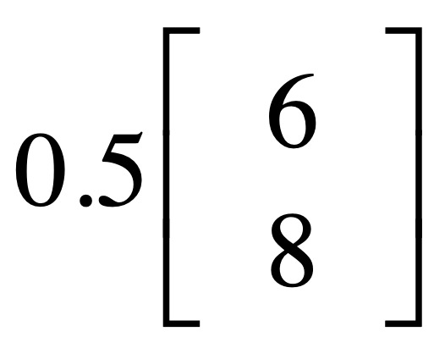
y
8
x
6

Slide 12
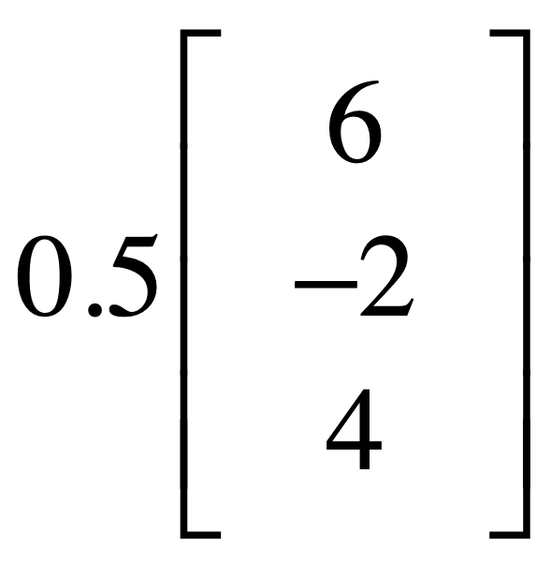
z
4
6
x
-2
y

Slide 13
vector addition

Slide 14
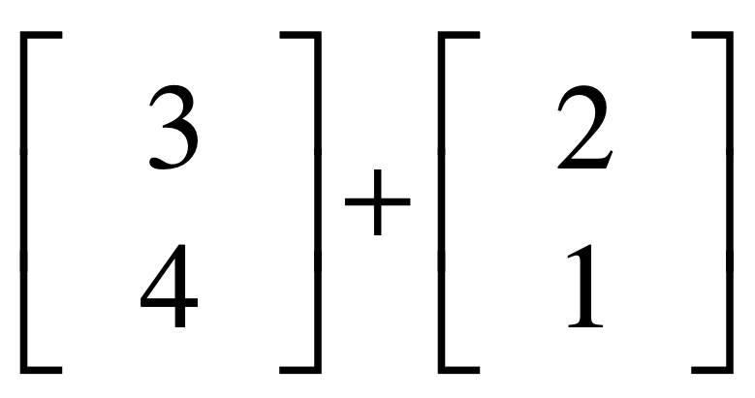
y
4
1
x
2
3

Slide 15
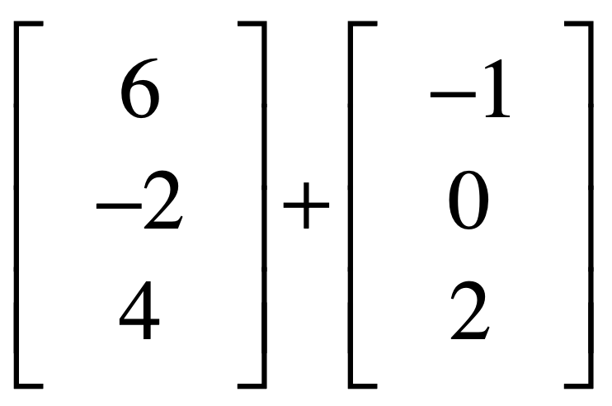
z
6
4
2
6
x
-1
-2
y

Slide 16
Vector spaces

Slide 17
Requirements
to become a vector space:
linear combinations
still stay in the space

Slide 18
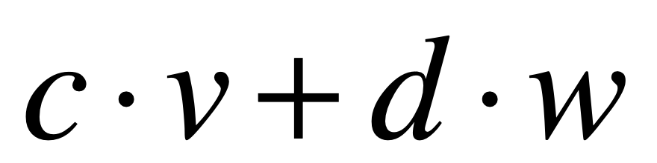
linear combinations
scalars
vectors

Slide 19

e.g., not a vector space
y
linear combinations
can’t stay here
x

Slide 20
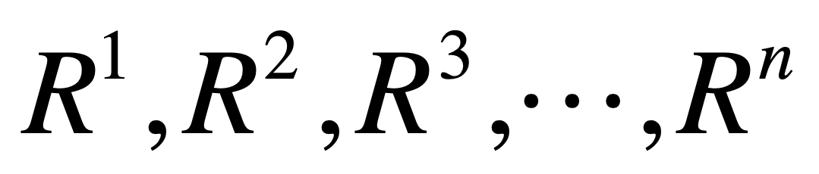

Slide 21
R^{n} space
consists of all vectors
with n components

Slide 22
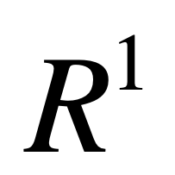
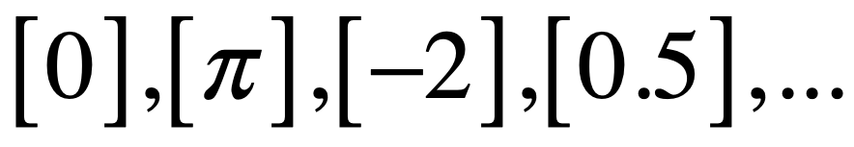
-2
0
0.5
π

Slide 23
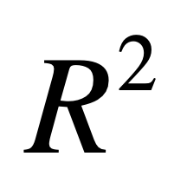
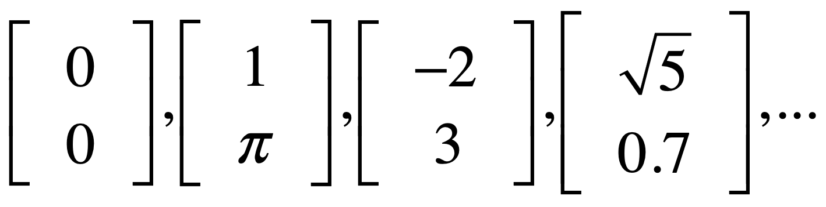
y
3
x
-2
1

Slide 24
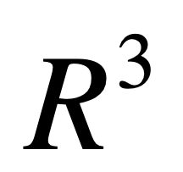
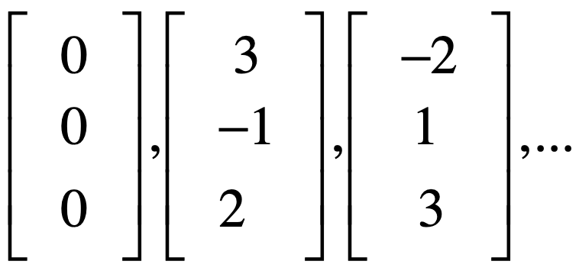
3
z
2
1
-2
3
x
-1
y

Slide 25
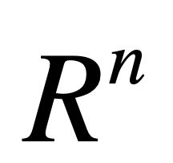
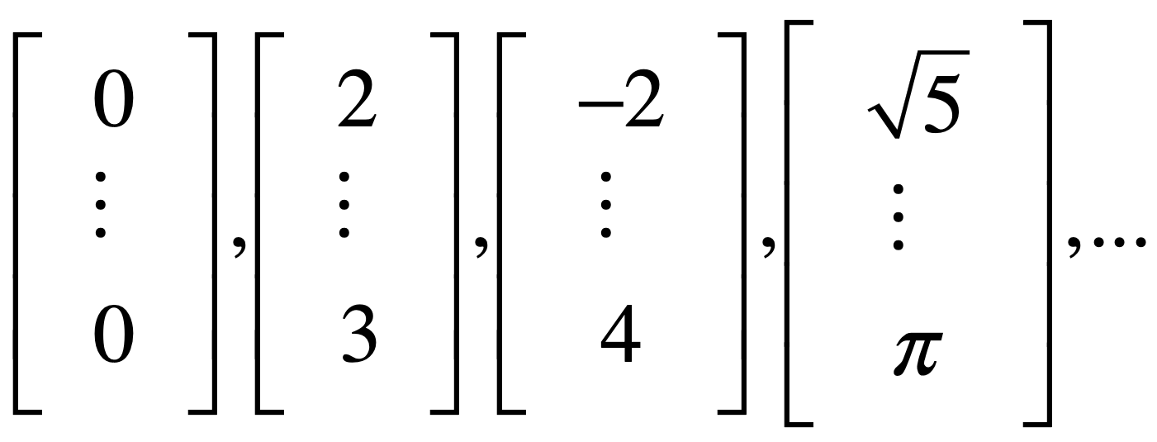

Slide 26
Column space

Slide 27
Columns of A^{mxn} in R^{m},
all their linear combinations
form a subspace:
column space, C(A)

Slide 28
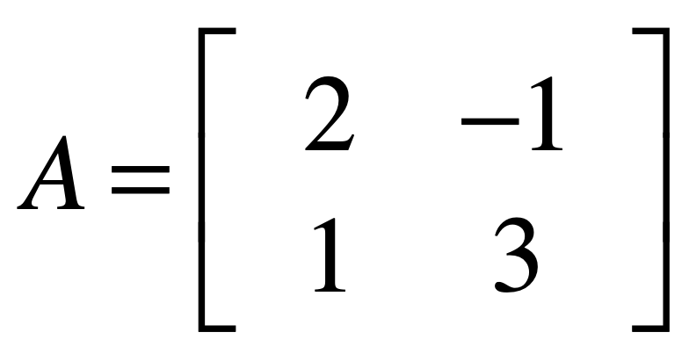

Slide 29
y
col2
3
col1
1
x
-1
2

Slide 30
col1 & 2 NOT on a line
-> independent

Slide 31
all their linear combinations?

Slide 32
y
x

Slide 33
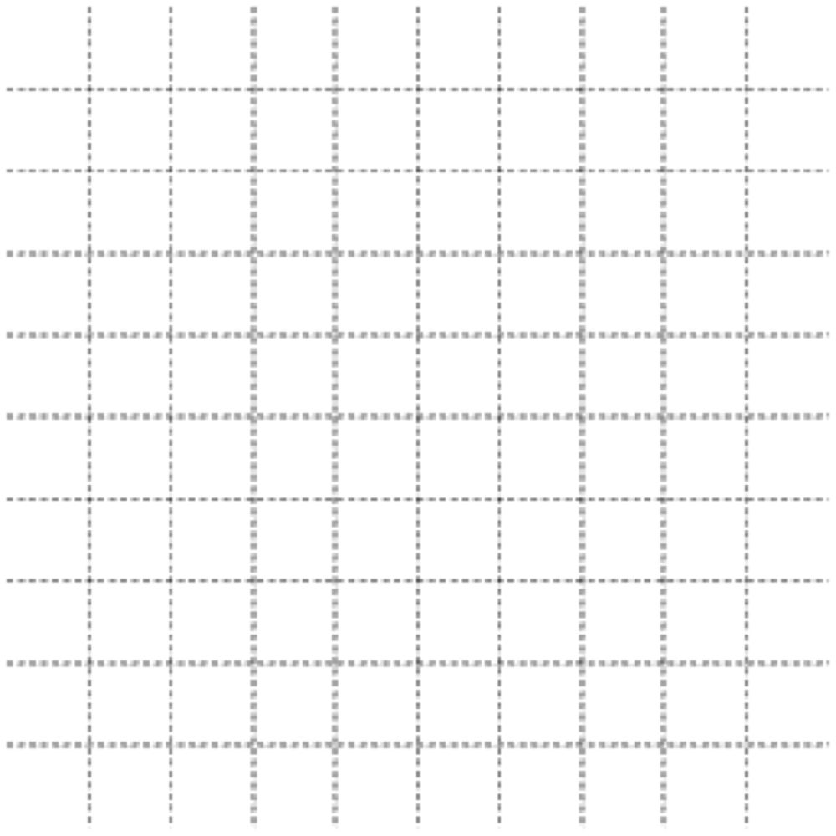
y
x
Whole space: R²
Column space: R²

Slide 34
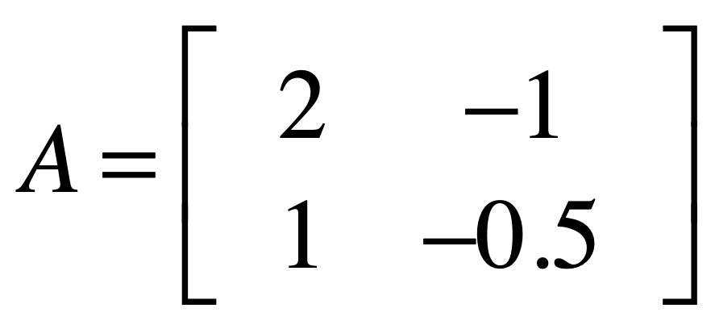

Slide 35
y
3
col1
1
x
-1
-5
2
col2

Slide 36
col1 & 2 on a line
-> dependent

Slide 37
all their linear combinations?

Slide 38
y
x
Whole space: R²
Column space: L

Slide 39
dim(whole space)
n rows
dim(column space)
n of independent columns

Slide 40
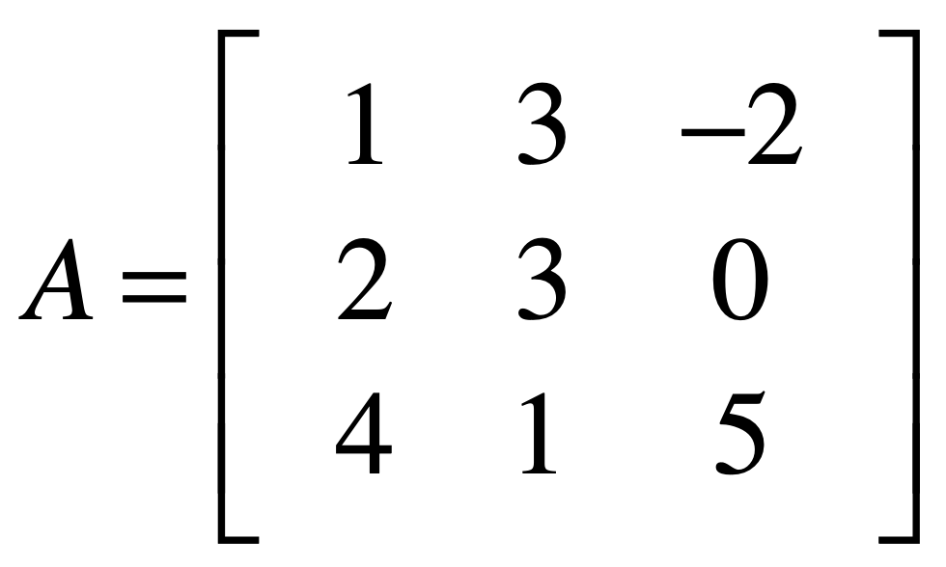
Whole space: R³
Column space: R³

Slide 41
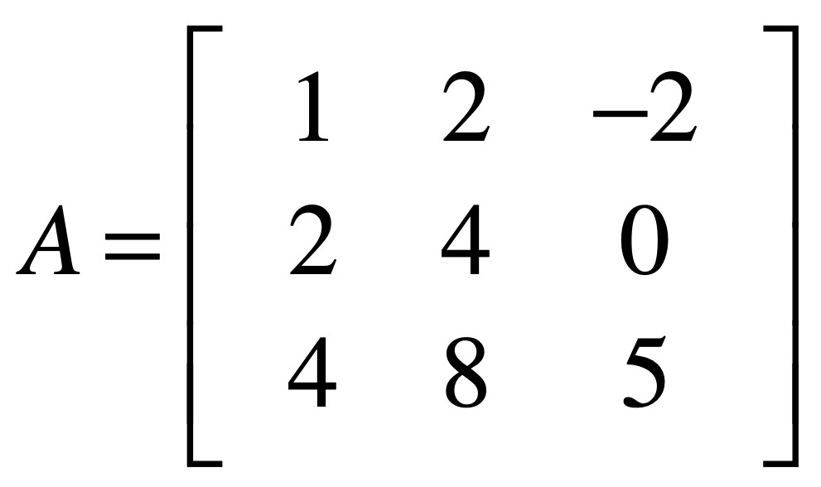
Whole space: R³
Column space: P

Slide 42
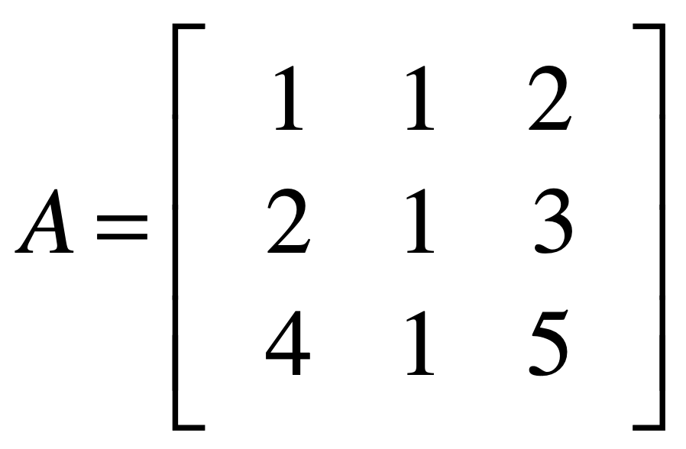
Whole space: R³
Column space: P

Slide 43
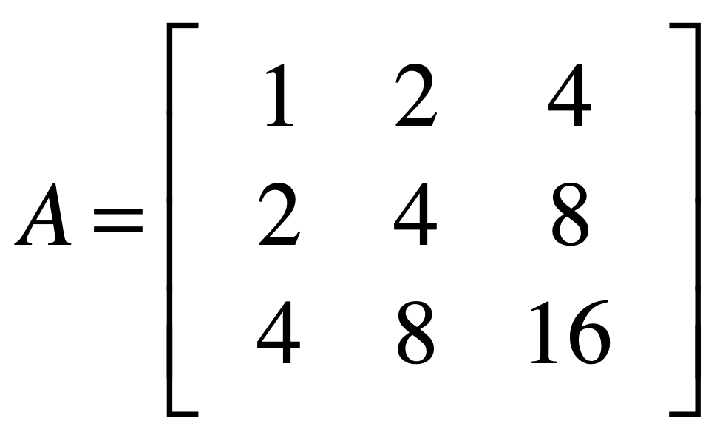
Whole space: R³
Column space: L

Slide 44
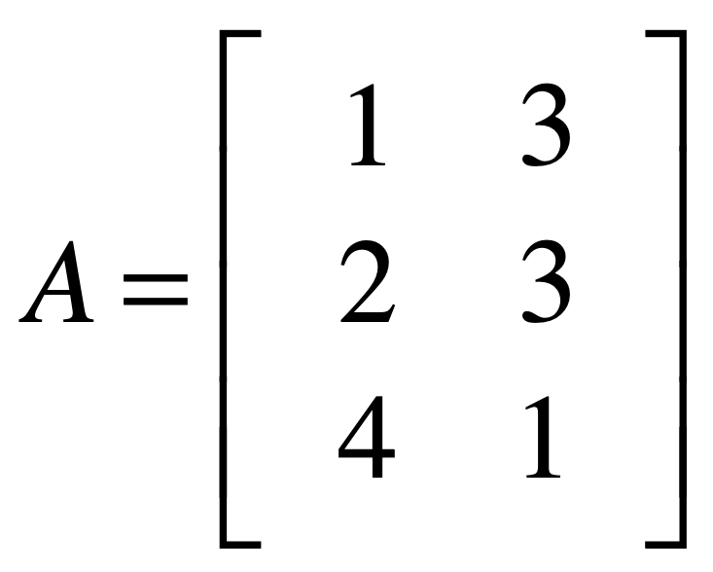
Whole space: R³
Column space: P

Slide 45
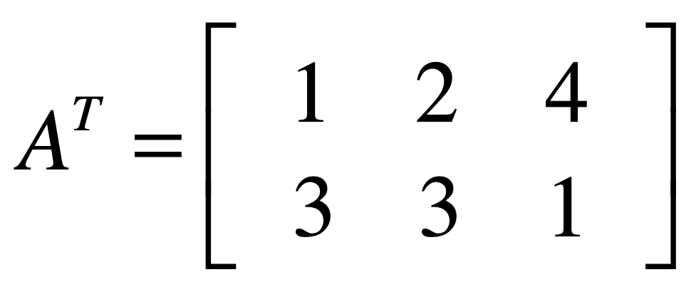
Whole space: R²
Column space: R²

Slide 46
Four spaces in a matrix

Slide 47
An mxn matrix
has two whole spaces:
R^{m} and R^{n}

Slide 48
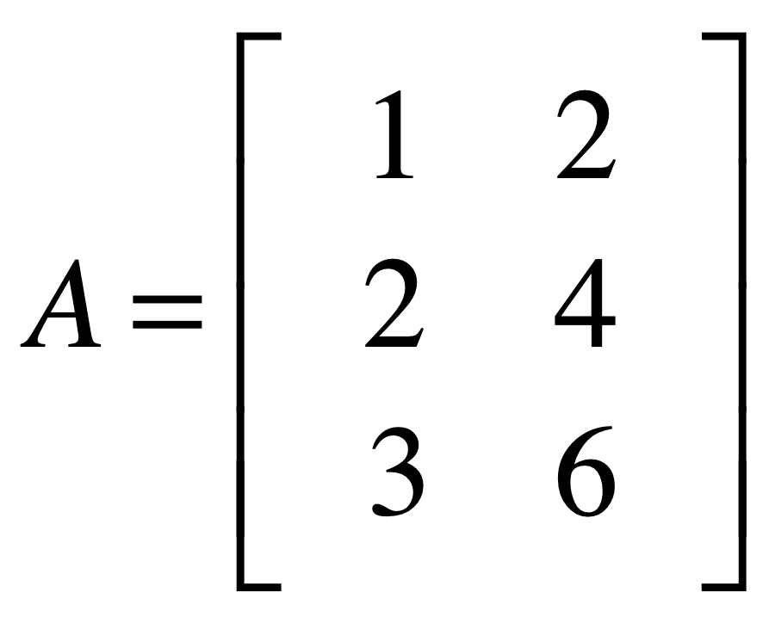

z
R³
x
whole space (column)
y
y
R²
whole space (row)
x

Slide 49

z
R³
column space
x
whole space (column)
y
y
R²
whole space (row)
row space
x

Slide 50
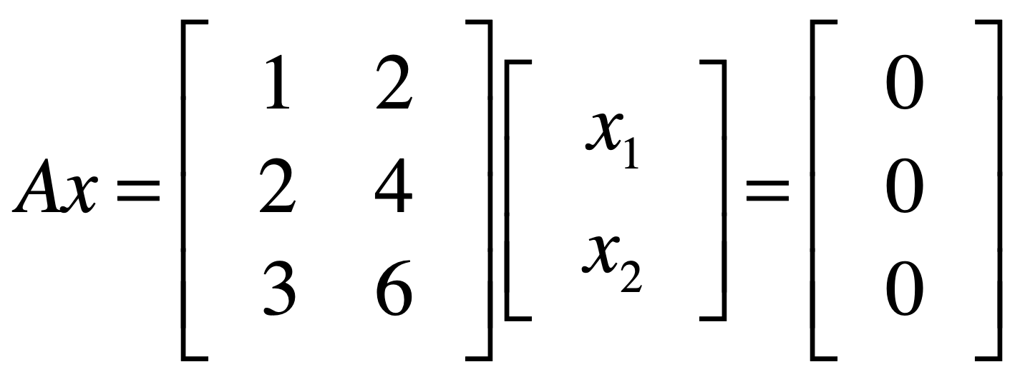
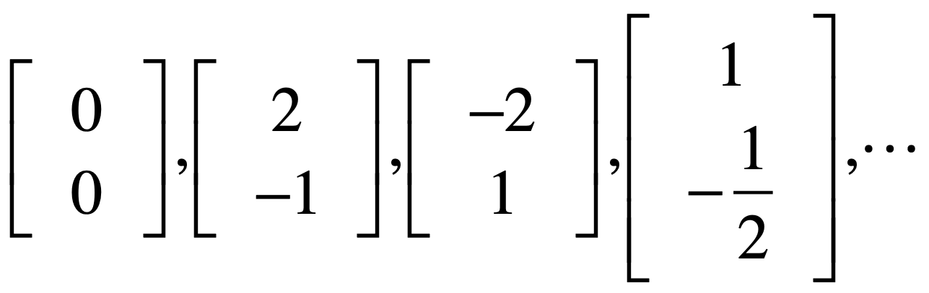
null space
Notes:
어떤 vector가 Null space를 따라 움직이면 그 vector의 값이 바뀌어도 결과값은 변하지 않는다.

Slide 51
z
R³
column space
x
whole space (column)
y
y
R²
whole space (row)
null space
row space
x

Slide 52
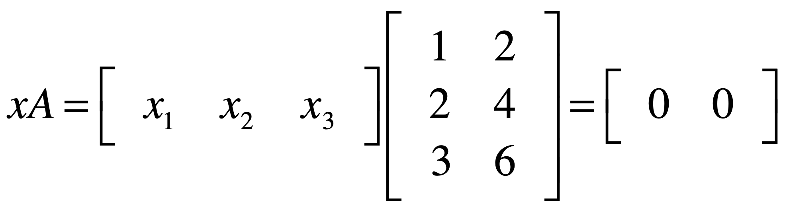
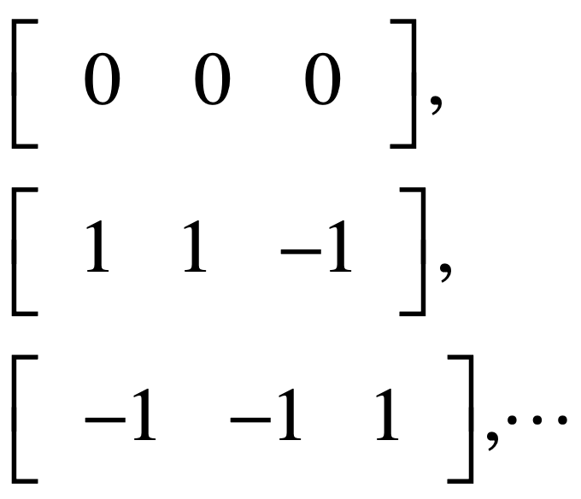
left null space

Slide 53
z
R³
column space
left null space
x
whole space (column)
y
y
R²
whole space (row)
row space
x

Slide 54
z
R³
column space
left null space
x
whole space (column)
y
y
R²
whole space (row)
null space
row space
x

Slide 55
row space
null space
r
n-r
column space
r
whole space (column)
m
left null space
m-r
n
whole space (row)

Slide 57
Linear transformation

Slide 58
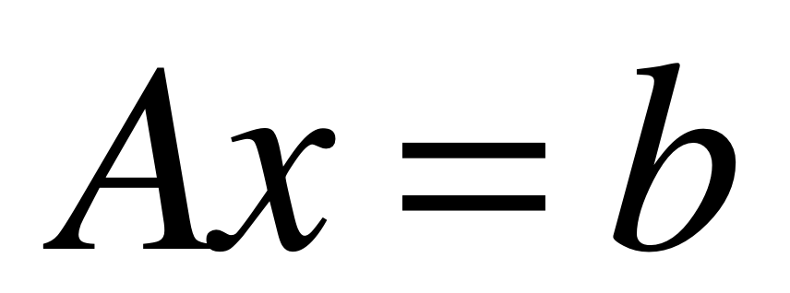

Slide 59
place x on original grid
transform x onto A grid
read transformed x
on original grid (=b)

Slide 60
example 1

Slide 61
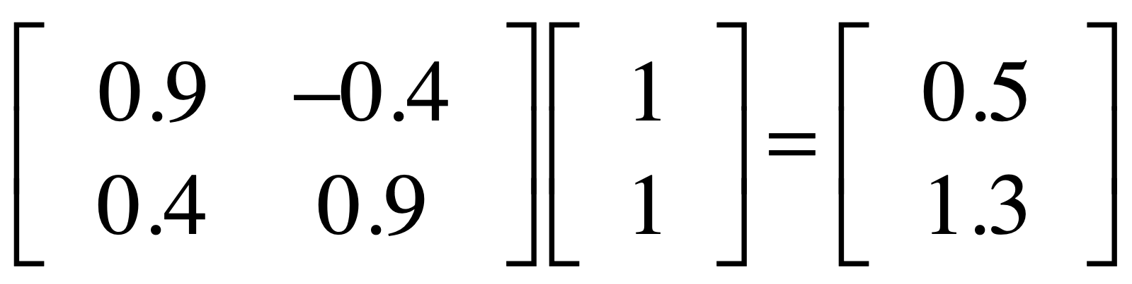

Slide 62

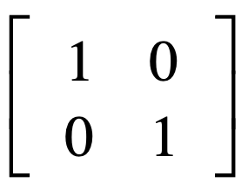
basis vector
basis vector
original grid

Slide 63

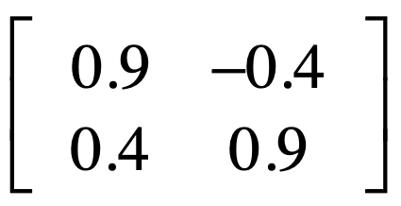
basis vector
basis vector
A (transformation) grid

Slide 64
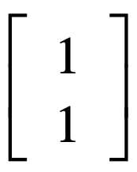

Slide 65
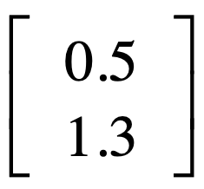

Slide 66
example 2

Slide 67
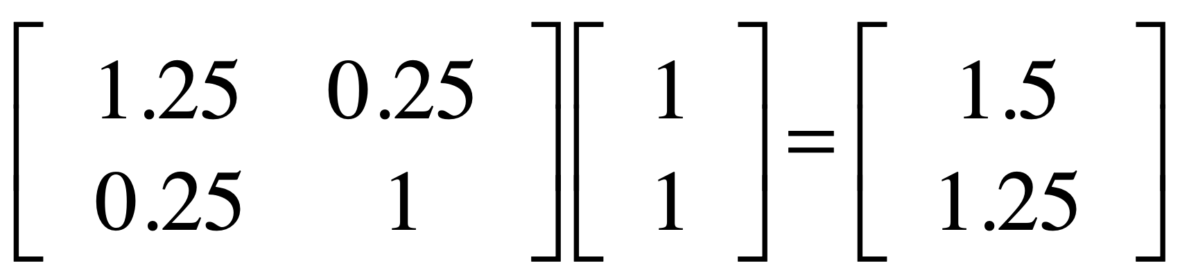

Slide 68
basis vector
basis vector
original grid

Slide 69

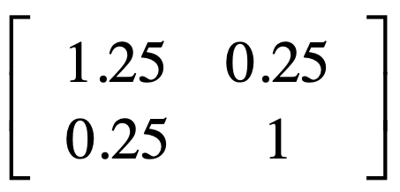
basis vector
basis vector
A (transformation) grid

Slide 71
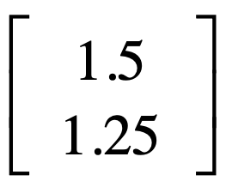

Slide 72
example 3

Slide 73
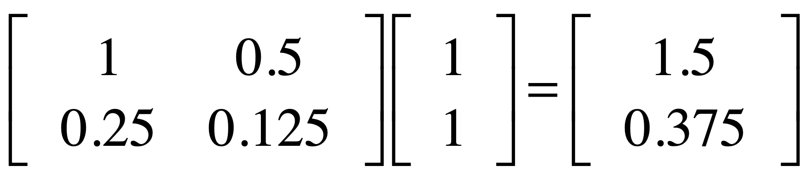

Slide 74
basis vector
basis vector
original grid

Slide 75
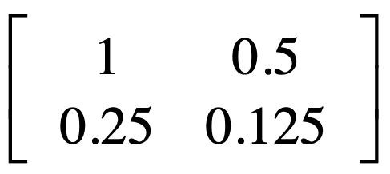
basis vectors
A (transformation) grid

Slide 77
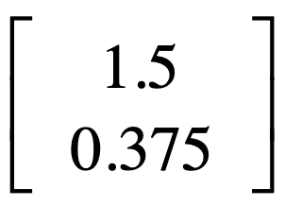

Slide 78
Detransformation:
Inverse matrix

Slide 79
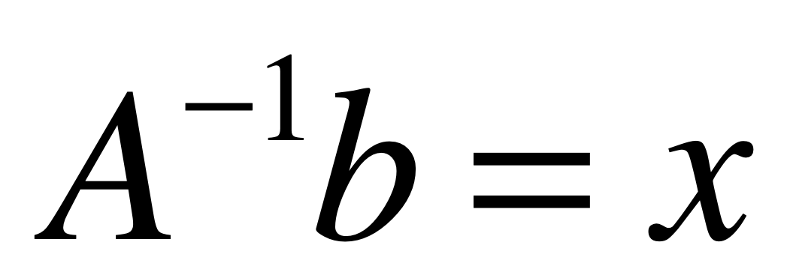

Slide 80
example 1

Slide 81
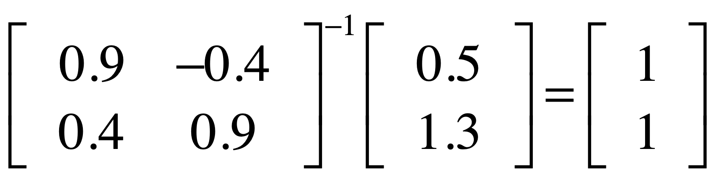

Slide 82
basis vector
basis vector
A (transformation) grid

Slide 83
basis vector
basis vector
original grid

Slide 86
example 2

Slide 87
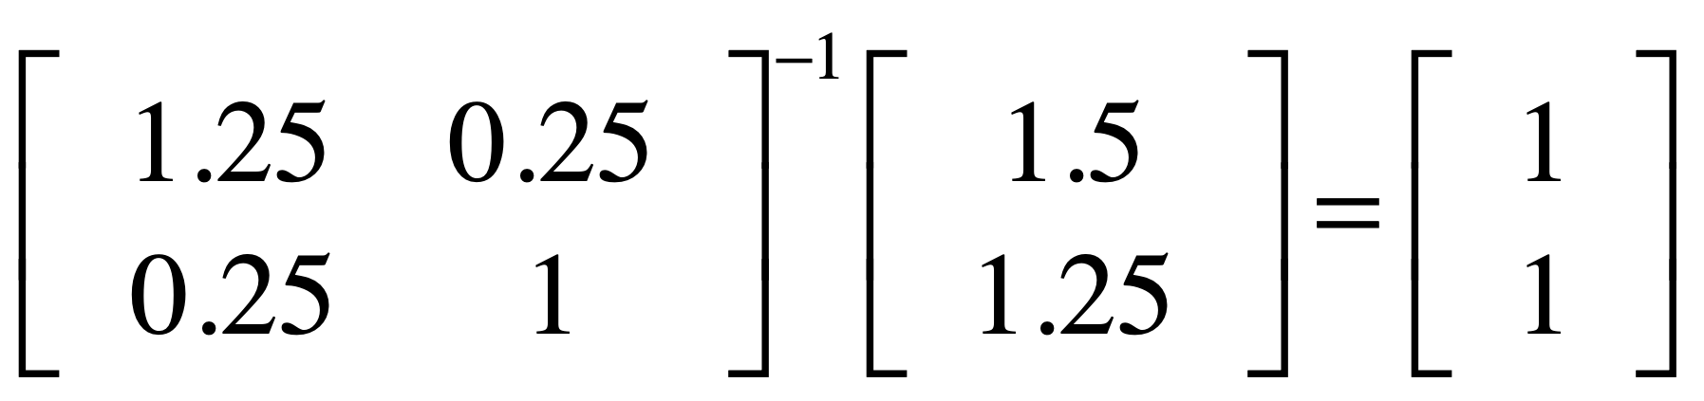

Slide 88
basis vector
basis vector
A (transformation) grid

Slide 89
basis vector
basis vector
original grid

Slide 92
example 3

Slide 93
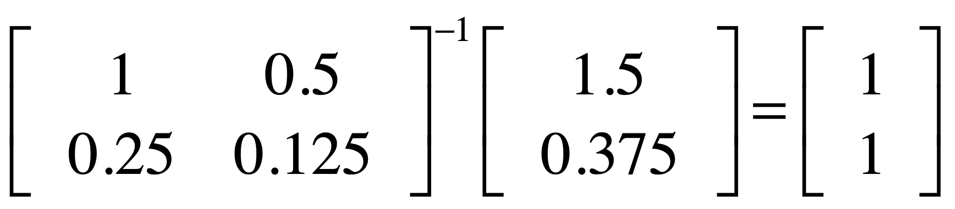

Slide 94
basis vector
basis vector
original grid

Slide 95
basis vectors
A (transformation) grid

Slide 97
?
?
?
not invertible
?
?
?
?
?
?
?

Slide 98
eigenvector

Slide 99
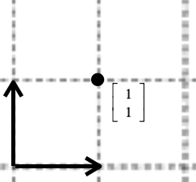

Av=b
A transforms v to b
x space
b space

Slide 100
Among all v,
some v is parallel to Av.
that v is eigenvector

Slide 101


Slide 102
Visualizing
eigenvectors
http://setosa.io/ev/eigenvectors-and-eigenvalues/

Slide 103



Slide 104

eigenspace
Notes:
벡터의 내적
기하하적 해석? a * b 일 경우 a벡터를 b벡터 위에 수직으로 내리는 것.
스펙트로그램을 직접 만들기 위해서.
스펙트럼도 벡터.
이 벡터에다가 sine wave들을 여러 개 만듬(100hz, 1000hz, 2000hz…)
이것들을 내적(inner product)하면 어떤 값이 나오는데
유사한 성분이 많으면 그 결과값이 높게 나오고 아니면 낮게 나온다.
이 원리를 이용해서 spectrogram을 만들 것이다.

